Slide 1
White Hat Security Sollutions
Scott Reynolds
David Bomar
John

Slide 2
Mission Statement
Our mission is to bring in depth and complete network and internet solutions for your small to medium business and enterprise needs.

Slide 3
Business Goal
Our business goal is to run a profitable operation, which typically means increasing revenue while limiting expenses. To reach the is goal, objectives could consist of increasing annual sales by ten percent of landing three new accounts each month.

Slide 4
Services Offered
Cybersecurity policies and procedures
Incident response and procedures
Network penetration procedures

Slide 5
Cybersecurity policies and procedures
Access authorization policy
Workstation use policy
Cloud storage policy
Data backup and restore policy
Email usage policy
Media destruction, disposal, and re-use policy

Slide 6
Incident response procedures
Incident response plan development
Incident response policy development
Incident response breach notification procedures
Incident response training
Operation security
Business continuity and disaster recovery planning

Slide 7
Network penetration testing
External Network testing
Web Application testing
Wireless Network testing
Social Engineering testing

Slide 8
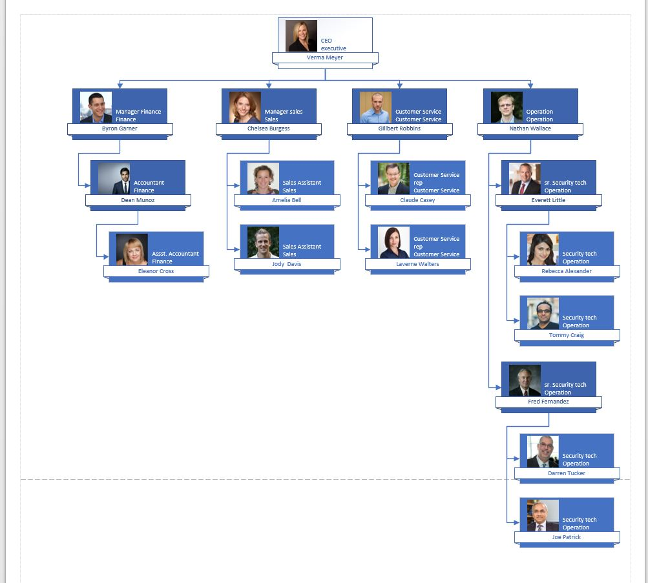

Slide 9
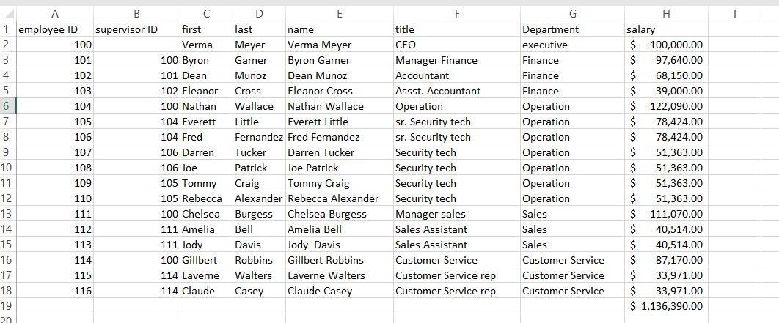

Slide 10
